Slide 1
System Design Basics
- By Sabarish Nair

Slide 2
What is system design?
Process of defining the architecture, interfaces, and data based on the customer requirements.
Think in terms of:
Infrastructure
Hardware
Software
Data
Storage

Slide 3
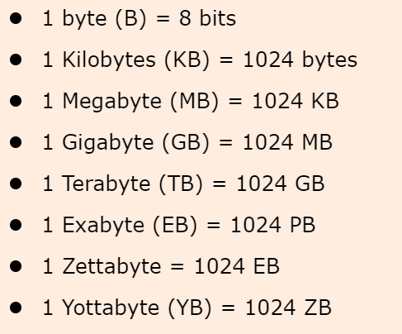
Numbers: BITS and BYTES

Slide 4
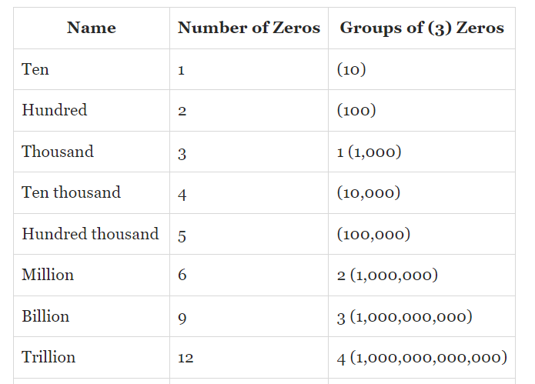
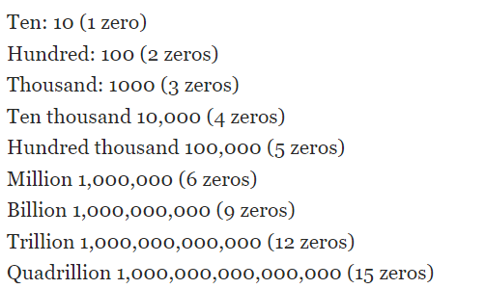
Numbers: Game of 10s

Slide 5
Quick Calculations
1 million transactions a day = 12/sec
1 million transactions a day = 700/min
1 million transactions a day = 42000/sec
Example:
5 million a day = (12 * 5) = 60/sec
30 million a day = (12 * 30) = 360/sec
100 million a day = (12 * 100) = 1200/sec

Slide 6
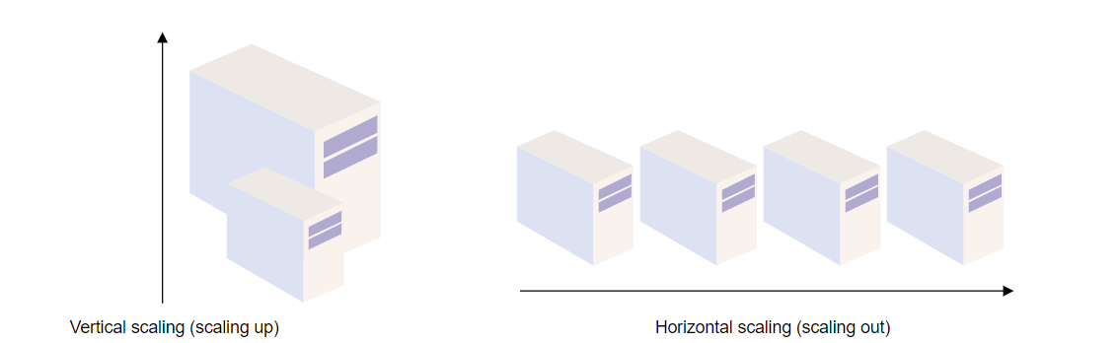
Scaling
Handle and withstand an increased workload without sacrificing latency.
Horizontal Scaling (Scaling-out): Adding more hardware to the existing hardware pool.
Vertical Scaling (Scaling-up): Add more power to your server.

Slide 7
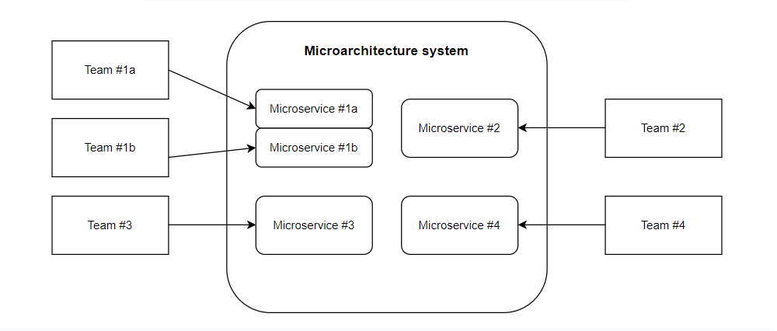
Micro services
Structures an application using loosely coupled services
Divides a monolithic application to loosely coupled services

Slide 8
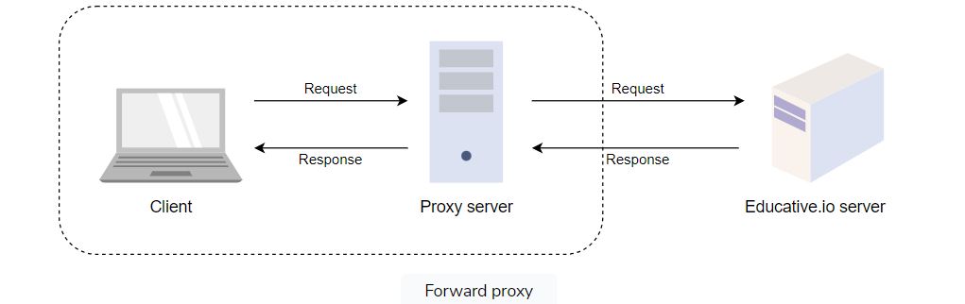
Proxy Servers
Also known as forward proxy
Acts as a channel between a user and the internet
Forwards user requests. Whenever a user sends a request for an address from the end server, the traffic flows through a proxy server on its way to the address. When the request comes back to the user, it flows back through the same proxy server which then forwards it to the user.
Helps in Improved security, Improved privacy, Control of the internet usage of employees and children, Cache data to speed up requests

